Slide 1
intro to python
Shannon Turner
Twitter: @svt827
GitHub: @shannonturner

Slide 2
Learn about variables
Learn what strings are
Learn how to display and modify them
Learn what conditionals are
Learn how to use conditionals to change how your program behaves

Slide 3
Variables
Variables are containers for information; you can store text, numbers, or any other type of thing!
twitter = "@hearmecode"
members = 902

Slide 4
The print command
Use the print command to show some information to the screen.
print "Welcome to Hear Me Code!"
print 'No boys allowed!'
Since we created a variable on the previous slide, we can use it now:
print twitter

Slide 5
The print command
Let's take a closer look at the difference between these two:
print twitter
print "twitter"

Slide 6
Strings: The basics
Strings are a way to store information
Addresses
Email addresses
URLs
Names (people, places, …)
Phone Numbers
so much more (anything with text!)

Slide 7
Strings: The basics
Strings are combinations of characters
Letters
Numbers
Punctuation
Basically anything you can make on the keyboard and then some
Special characters, like tabs and newlines

Slide 8
Strings: The basics
How to spot a string: it has quotes around it
"This is a string"
'This is also a string'
Using single or double quotes comes down to personal preference … as long as you start and end a string with the same quote
'Not like this :("

Slide 9
Strings: the basics
If your text contains a single quote, you'll want to use double quotes around your text: If you don't, you'll get an error: Try both of these out!
Notes:
Take time to let everyone try it out. Explain how Python gets confused and thinks the string ends early. Use your hands and point it out on the screen.

Slide 10
Strings: the basics
If you have a really long string, use three quote symbols in a row to start and end your string.
Notes:
Note how the string contains both single quotes and double quotes as part of the actual text, and that this would be difficult without using a triple quote.

Slide 11
Strings: the basics
Special Characters
\n Newline
\t Tab

Slide 12
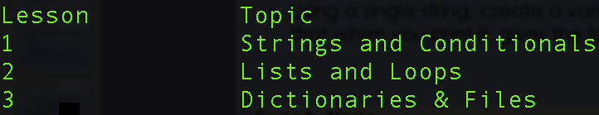
Strings: Quick Exercise
Print the following string:
Keep in mind you’ll need to use tabs & newlines!
Notes:
Emphasize that there are many ways to approach this, including using a triple-quoted string or by adding special characters within a single-quoted string.
Re-emphasize this once you bring it back.

Slide 13
How long is my string?
twitter = "@hearmecode"
len(twitter)
len() works on lists, too! We'll work with lists in Lesson 2.
Notes:
len( ) measures the length of whatever is inside the parentheses.

Slide 14
Strings: slicing
twitter = "@hearmecode"
Slicing lets you see individual pieces or “slices” of your string*
*Slicing also works with lists in the same way.
Notes:
Slicing is like writing a single character — letters, spaces, numbers, punctuation, everything — on each slice of bread in a loaf.
Use your hands a lot.

Slide 15
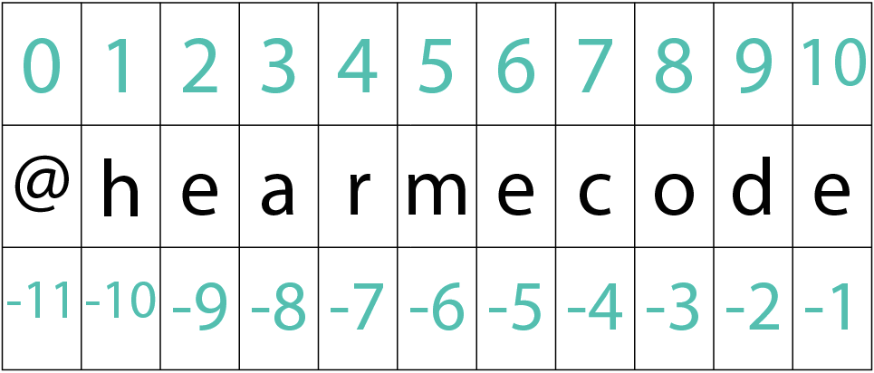
Strings: slicing
twitter = "@hearmecode"
Simple slices: twitter[0]
Here, 0 refers to the index that you want to see
Slicing on first_name and last_name can give us a person’s initials; slicing on phone number can give area code
Notes:
When slicing, Python starts counting at zero. This is tricky to remember at first, but you'll get used to it!

Slide 16
Strings: slicing
You can return more than one item in a slice
twitter[1:5]
The index on the left (1) is where you start
The index on the right (5) is where you end, but Python stops short and doesn’t include it
Notes:
Emphasize that the second slicing number isn't inclusive — the returned value stops just short of the second slicing number.
Mnemonic: How many characters do you get back? 5 - 1 = 4

Slide 17
Strings: slicing
The indices you provide are optional!
twitter[:5]
The left index is not provided, so Python assumes you want to start at the beginning and stop just short of item 5

Slide 18
Strings: slicing
The indices you provide are optional!
twitter[1:]
The right index is not provided, so Python assumes you want to start at item 1 and go to the end

Slide 19
Strings: slicing Exercise
phone = "(202) 456-7890"
Use slicing to print out the area code
And then the middle three numbers

Slide 20
Strings: STRING FORMATTING
Think of the numbers as placeholders for your variables (or like Mad libs!)
Remember, Python starts counting at zero. So zero is the first variable, which corresponds to name
Notes:
Be sure to mistakenly print "My name is: {0} and my age is: {1}" without the .format() to emphasize what .format() actually does.

Slide 21
Strings: STRING FORMATTING
You can use slicing with .format()
What does phone[4:] evaluate to?

Slide 22
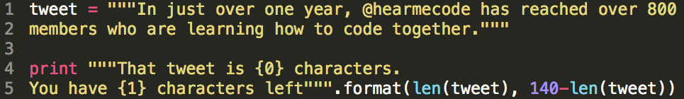
Strings: STRING FORMATTING
You can also do math inside .format()!
And use functions!
And so much more!

Slide 23
Strings: formatting Exercise
phone = "202-555-9876"
Use .format() and slice the phone variable to print these:
Area Code: 202
Local: 555-9876
Different format: (202) 555-9876
Notes:
Why do we need to use quotes around the phone? What happens when we don't?

Slide 24
Strings: STRING Methods
String methods let you perform special actions on your strings
Replace one part of a string with another
Find one part of a string within the string
Count the number of times one part of a string appears within the string
… and many more!

Slide 25


Strings: STRING Methods
.find(): Like Ctrl+F in most programs
The number you get back is the index (slice) where you found the item.

Slide 26
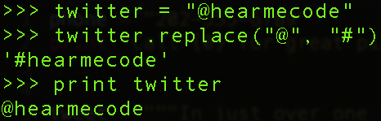
Strings: STRING Methods
.replace(): Like Find+Replace in Word, Excel, etc. … wait a second! Why didn't it save the changes?
Notes:
Our hashtag is the same as our twitter handle, so we can use the variable for both purposes!

Slide 27

Strings: STRING Methods
Change it just for now:
Making the changes stick:
Notes:
Be sure to spend some time on this and have folks try it out. The reasons behind it are a bit out of scope for lesson 1, but allude to the fact that both behaviors are useful, and just knowing that we can do either is helpful.

Slide 28
how functions work
Arguments/parameters tell a function or method how to do their action, or what to do it to.
len(tweet)
Function (action): len()
Argument/parameter: tweet

Slide 29
how functions work
Arguments/parameters tell a function or method how to do their action.
twitter.replace("@", "#")
Function (action): .replace()
Argument/parameter: "@" and "#"
Where does Python perform the find/replace? On the string that comes before the dot!

Slide 30
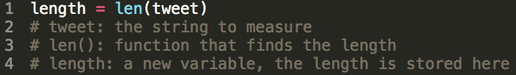
return values
Some functions and methods give you return values when they’re finished so you know what happened.
You can save this return value into a variable.

Slide 31
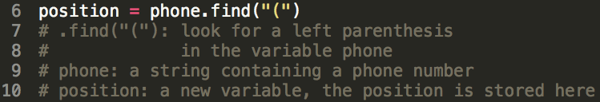
return values
Some functions and methods give you return values when they’re finished so you know what happened.
You can save this return value into a variable.
Notes:
This example will find the start of the area code.

Slide 32
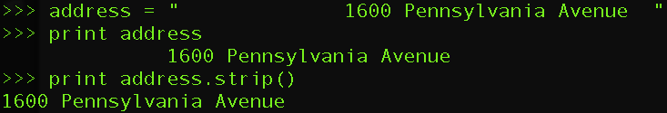
Strings: STRING Methods
.strip()
Removes whitespace from the beginning and end of a string (not the middle)

Slide 33
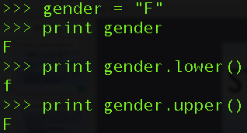
Strings: STRING Methods
.lower()
.upper()
Converts a string to all lowercase or all uppercase

Slide 34
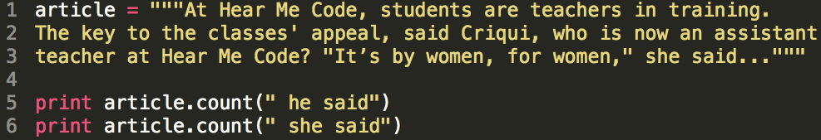
Strings: STRING Methods
.count()
How many times was a woman quoted in this article?
How many times was a man quoted?

Slide 35
cONDITIONALS
The basics
Operators
Compound conditionals
Using conditionals to change program behavior

Slide 36
cONDITIONALS
Conditional: just a fancy name for a yes or no question
Conditionals are ways to compare things and use that information to make decisions
Conditionals can let you change the behavior of your program

Slide 37
cONDITIONALS
Ways to think about conditionals
Is this a valid email address?
Does my phone number have enough digits?
Are more people signed up for my event than the room can hold?

Slide 38
cONDITIONALS
Conditionals are paired with if statements, which ask whether or not the conditional is true
if gender == 'f':
print "Welcome to Hear Me Code!"
True or False, is gender equal to "f"?
If so, they can join Hear Me Code. Otherwise, they can't!
Notes:
The most common mistake when writing conditionals is forgetting the colon at the end.
Emphasize that when you're comparing two things, we use two equal signs. When you're assigning one variable to one value, use one equal sign.

Slide 39
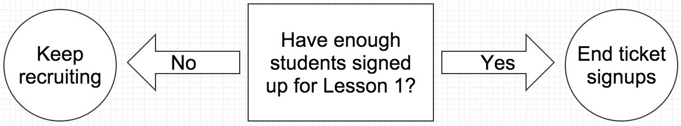
cONDITIONALS

Slide 40
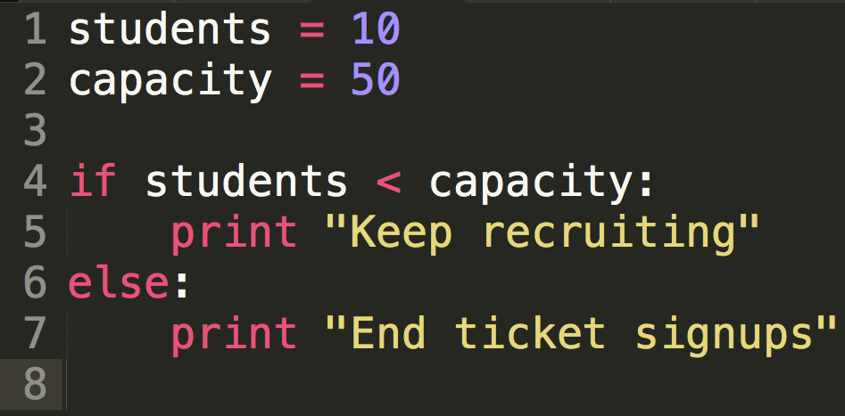
cONDITIONALS
Notes:
The second-most common mistake is adding a condition to the "else" portion.
Else is used as the catch-all for all other conditions that didn't match.

Slide 41
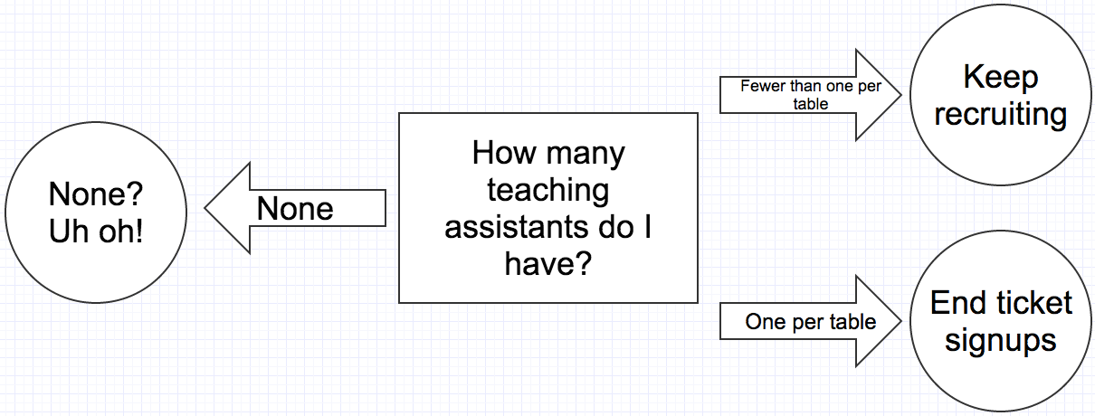
cONDITIONALS

Slide 42
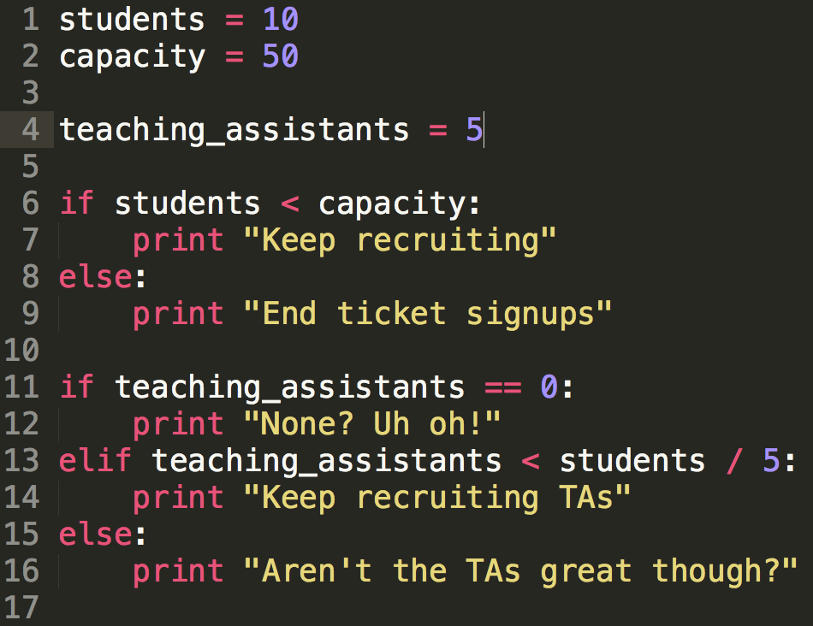
cONDITIONALS
Notes:
Important to note here: Lines 6-9 and 11-16 are evaluated separately.
In other words, the questions are asked separately.
Say that "elif" is "but, if"

Slide 43
cONDITIONALS
Operators (ways to compare two things)
== Equality operator (don’t confuse with a single equals sign)
5 == 7 # Python says: False
5 == 5 # Python says: True
Notes:
Mnemonic for the difference between = and ==:
= this one thing is equal to this other
== are these two things equal?

Slide 44
cONDITIONALS
Operators (ways to compare two things)
> Greater than operator
5 > 7 # Python says: False
5 > 2 # Python says: True

Slide 45
cONDITIONALS
Operators (ways to compare two things)
== These two things are equal
!= NOT! equal to
> Greater than
< Less than
>= Greater than or equal to
<= Less than or equal to
Notes:
Be sure to announce the mnemonic for !=:
This is NOT! equal
This is also a good time to rehash the equality operator. These TWO things are equal.

Slide 46
cONDITIONALS
if times_volunteered >= 5:
# send them a special thank-you
if donation >= 1000:
# add to the major donors list
Notes:
Again, emphasize that the code here would be too long to fit on the slide, so comments are here as a placeholder.
Now is also a good time to mention that comments are good for designing the structure of your program before you actually write the code.

Slide 47
cONDITIONALS: exercise
Create two variables (volunteers, goal)
Tell the user whether they are above, below, or at their recruitment goal.
Example: Current volunteers: 90 Goal: 100
>>> You are behind!
Notes:
The hardest part for most folks about this is knowing where to start, so create the variables and the first conditional before they get started.
As a stretch goal, how many volunteers are you above or behind by?

Slide 48
complex cONDITIONALS
You can use your string methods as part of the conditional!
if gender.lower() == "f":
# No matter how it's capitalized
if email_address.count("@") > 1:
# this isn’t a valid email

Slide 49
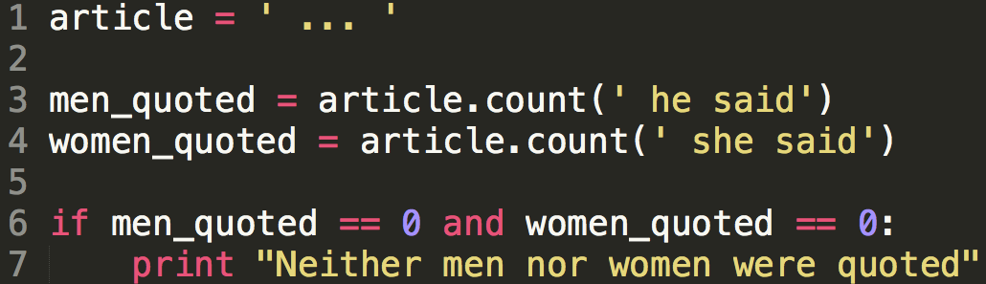
compound cONDITIONALS
Using the and keyword, both conditions must be true for the print statement at line 7 to run.

Slide 50
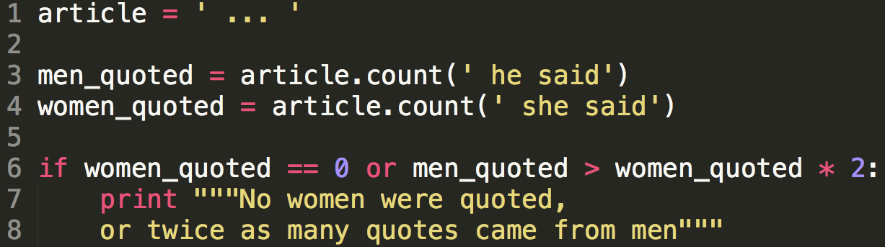
compound cONDITIONALS
Using the or keyword, either condition could be true for the print statement at lines 7-8 to run.

Slide 51
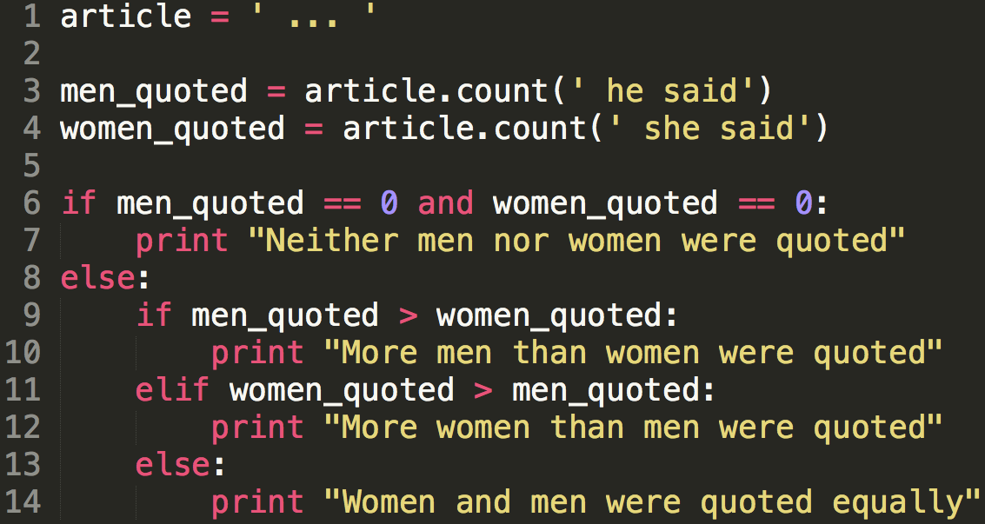
nested cONDITIONALS
Notes:
Explain how lines 9-14 will only run when a man or woman is quoted.

Slide 52
Playtime!
Head to Code Like a Girl's Python Lesson 1 Slides on Github, which has examples & code samples for the lesson:
Variables, math, and basics recap
Strings recap
Conditionals recap
See the playtime folder for the playtime exercise for this lesson.
Notes:
Note that you'll need to look at the math recap for more info on how to complete the playtime exercise.

